Slide 1
Quadtree for python
By Shikhar agarawal
112003005

Slide 2
Motivation
Python is easy to use and perform operation but slow compared to C when implementing Data Structures written purely in python
This is an attempt to:
i) Implemented Quadtree in C and used as library(module) in python resulting in faster implementation
ii) Perform Unit testing to check the library functions.

Slide 3
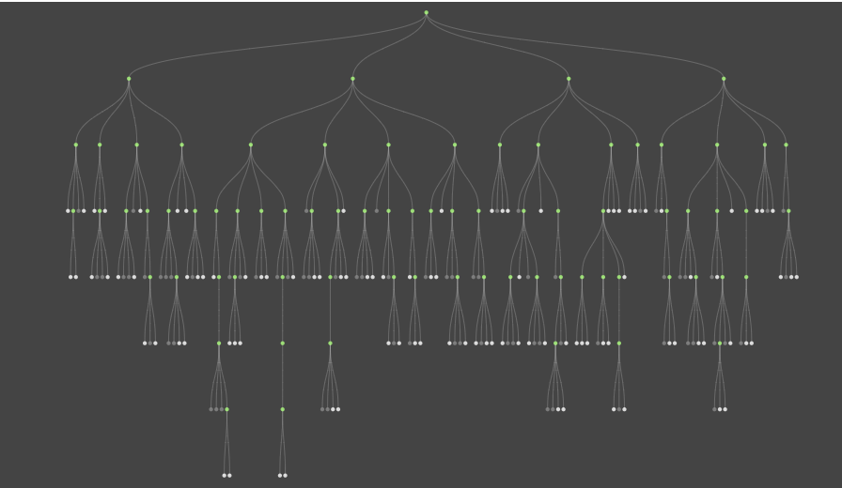
Quadtree

Slide 4
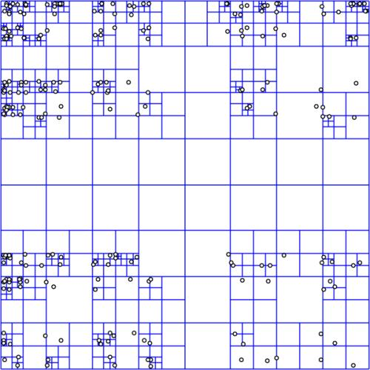
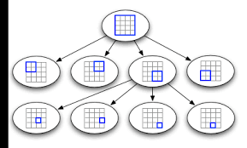
Spatial Indexing

Slide 5
Structure of the node & Tree
Typedef struct pqt_Qnode {
pqt_Leaf nw;
pqt_Leaf ne;
pqt_Leaf sw;
pqt_Leaf se;
} pqt_Qnode;
typedef struct quadtree {
pqt_Boundry boundry;
unsigned int maxsize;
unsigned int maxdepth;
pqt_Qnode *head;
} pqt_QuadTree;

Slide 6
Analysis
Addition of 10000 points to Quadtree Took 0.00216007232666 seconds using library(Module) created in C.
Addition of 10000 points to Quadtree Took 0.2066507339477539 seconds using Data Structure(Class)* created in Python.
*The Python code used for comparison was from the mentioned link https://github.com/calquezar/QuadTree/blob/master/QuadTree.py

Slide 7
Resources
https://ieeexplore.ieee.org/document/9700268/authors#authors
https://cython.readthedocs.io/en/latest/
https://medium.com/@waleoyediran/spatial-indexing-with-quadtrees-b998ae49336

